Slide 1
Learning Sparse Neural Networks using L0 Regularization - Varun Reddy G

Slide 2
Neural Networks
Very good function approximators and flexible
Scales well
Some problems
Highly overparameterized
Can easily overfit.
One of the Solutions:
Model Compression and Sparsification

Slide 3
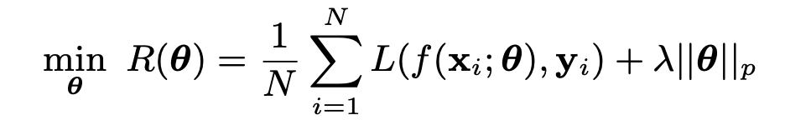
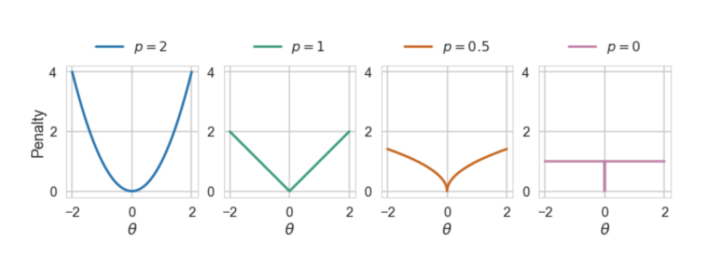
A typical L_{p} regularization loss would look like
Where ||θ||p is the L p norm and
L(.) is the loss function

Slide 4
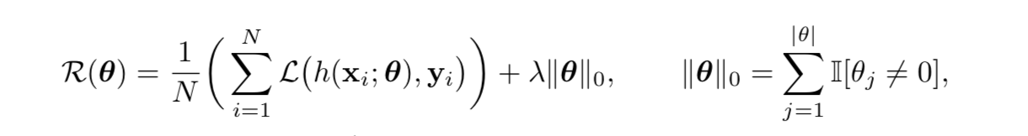
L₀ norm essentially means counting the number of non-zero parameters in the model.
It penalizes all non-zero values equally, unlike other Lp norms which penalize on the value of θ_{j} causing more shrinkage on higher values
So, now the error function looks like this
But, now this function is computationally intractable given non-differentiability and combinatorial nature of the 2 ^{|θ|} possible states for the parameter vector θ
So, we reformulate to try and make it continuous.

Slide 5
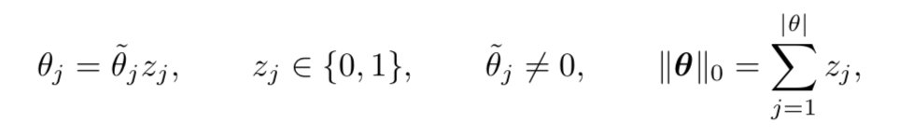
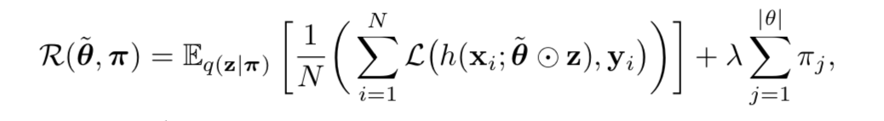
Consider the following re-parametarization,
Where, Z_{j} corresponds to the binary gates 0, 1 representing the parameter is present or not.
Now, if we consider q(z_{j} |π_{j} ) = Bern(π_{j}) distribution where π_{j} is the probability of 1, then we can reformulate the loss on average as
Now, the second term is easy to minimize, but the first term, due to the discrete nature of z, is difficult to optimize.

Slide 6
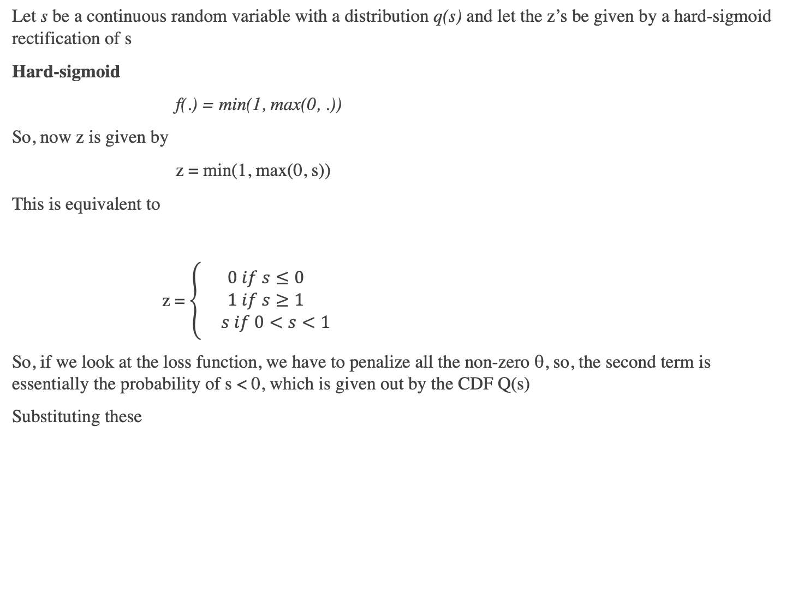
Let s be a continuous random variable with a distribution q(s) and let the z’s be given by a hard-sigmoid rectification of s
Hard-sigmoid
f(.) = min(1, max(0, .))
So, now z is given by
z = min(1, max(0, s))
This is equivalent to
z = $\left\{\begin{aligned}0 if s≤0 \\ 1 if s≥1 \\ s if 0<s<1\end{aligned}\right.$
So, if we look at the loss function, we have to penalize all the non-zero θ, so, the second term is essentially the probability of s < 0, which is given out by the CDF Q(s)
Substituting these

Slide 7
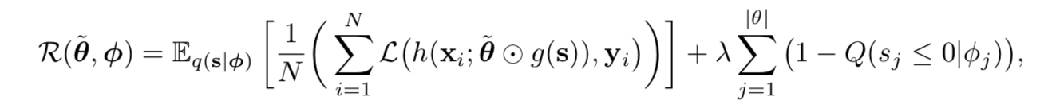
Our loss function becomes
where g(s) is our hard-sigmoid function.

Slide 8
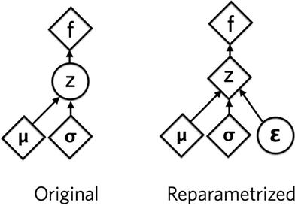
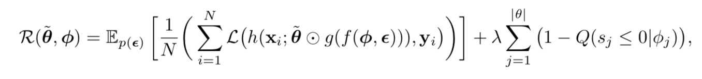
Re-parameterization Trick
We can choose q(s), with parameters ɸ such that they allow the re-parameterization trick and express the loss function as an expectation over a parameter free noise distribution p(ϵ) and a deterministic and differentiable transformation f(.) of the parameters ɸ and ϵ
P.S variables in the above definition do not correspond to those in the picture
Therefore, the objective now becomes,

Slide 9
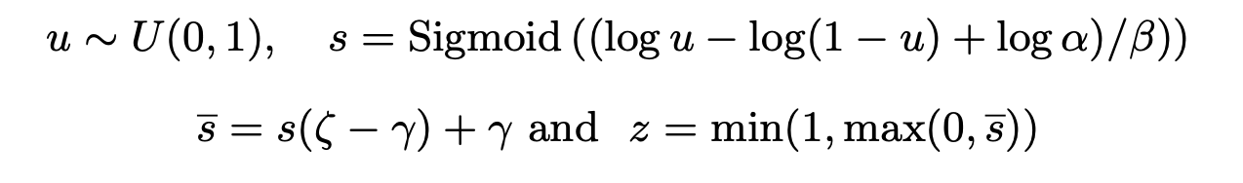
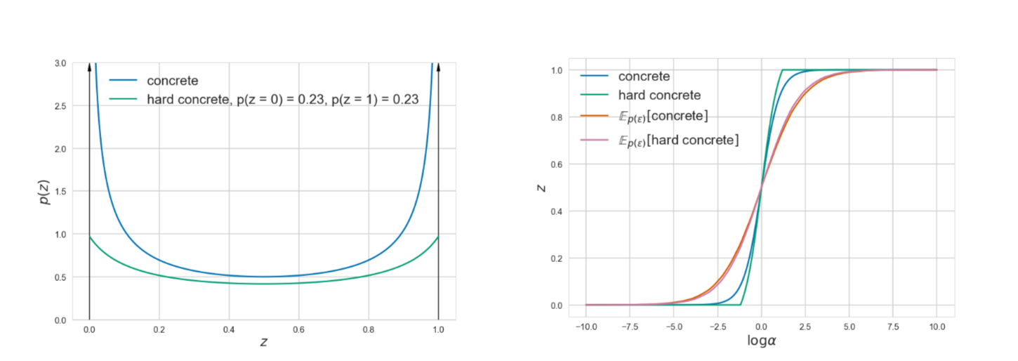
Choosing the q(s)
We are free to choose the q(s) and something that worked well in practice is a binary concrete random variable distributed in (0, 1) with probability density q_{s} (s| ɸ) and cumulative density Q_{s} (s | ɸ).
The parameters of this distribution are ɸ = (log ⍺, β) where, log ⍺ is location and β is temperature.
We stretch this distribution to an interval (ɣ, 𝛿) such that ɣ < 0 and 𝛿 > 0 and apply hard-sigmoid on its random samples

Slide 10
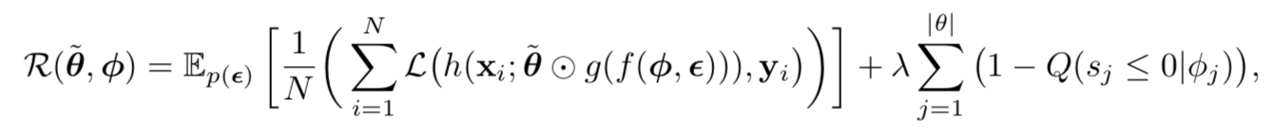
So, with the above changes, the objective function is
Eq. 9

Slide 11
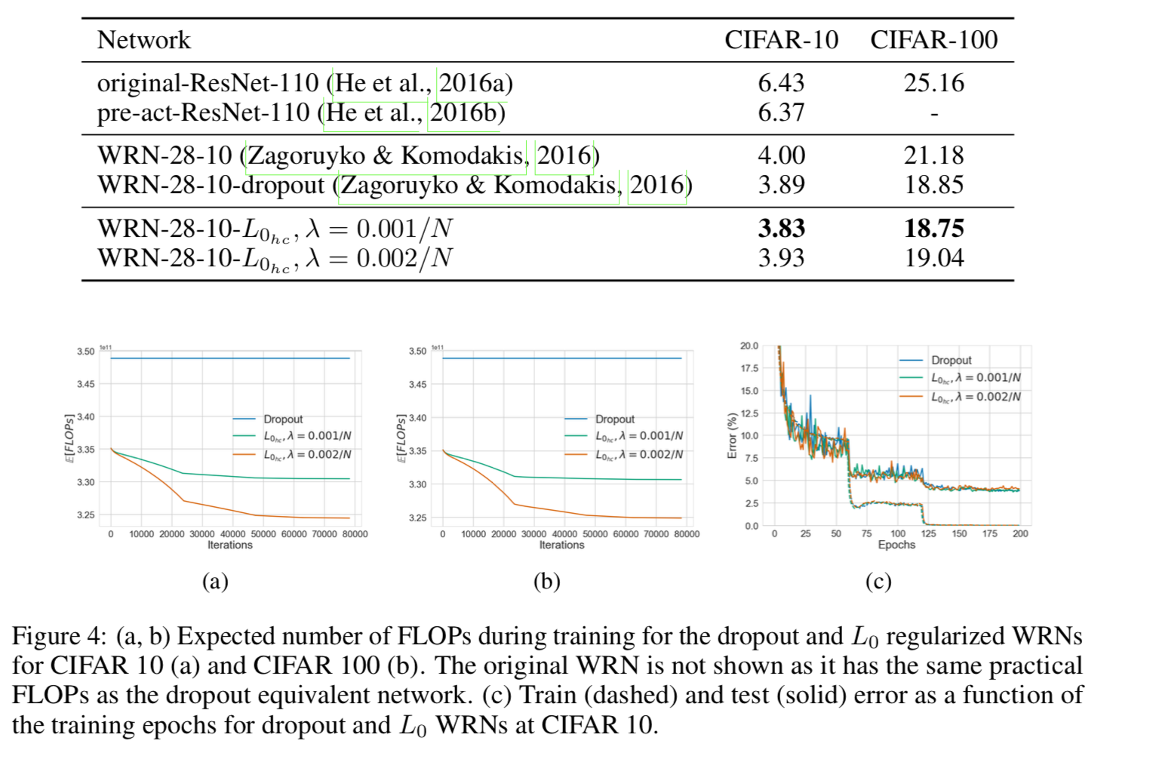
Results

Slide 12
Summary
Force the network weights to become absolute 0’s
To remove non-differentiability, re-parameterize
Now, to make the objective function continuous and to keep the sampling step out of the main network, use the re-parameterization trick.
Learn the parameters for the q(s) and use them at inference time, like so

Slide 13
Resources
Numenta Journal Club https://www.youtube.com/watch?v=HD2uvsAEZFM
Original Paper https://arxiv.org/abs/1712.01312

